Slide 1
Dette er ein test.
Test – Test.

Slide 2


Test - BBLS
MARS: 50.000 bbls.

Slide 4

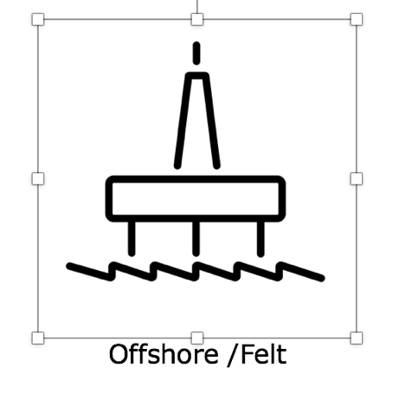

How to use icons in presentations
Select the icon itself, not the text.
2. Copy and paste into the desired slide.
3. Resize the icons by dragging one of the corners. It will be scaled propositional.

Slide 5














Exploration
Trading & shipping
Power generation
Vision
Mastery
Oil production
Barrel
Discovered resources
Offshore /Felt
Risk management
Documentation
Environment & Global
Suppliers
Local Communities
Innovation

Slide 6















BOED
Onshore
International
Chemical products
HSSEQ
Man & Woman
Cash flow
Investeringer
Norgeskart
Developing oil
and gas fields
Trust
Partnership
Honesty
Integrity
Collaboration & Team

Slide 7















Partner Operated Assets
Team development
Renewable
energy production
Sustainability
Work processes
Inclusion
Employees
Courage
Self development
Passion
IT
Building Maintenance
People
Communication
CEO

Slide 8















MOH
Report an Issue
New user request
User Modification
Request
Request Change With
Approvals
Mobile Phone and/or
Subscription Request
Other requests
Report Building/
Office Request
Building/
Office Request
Office Move Request
Setup Main Conferense
Room M126/M127
Canteen
Change
Exploration
& Subsurface
Production

Slide 9















Drilling
Finance
Growth
Achievement
Supply Chain
Management
Data and Document Control
Corporate Services
Flexibility
Openness
Will to win
Quality
Productivity
Objectives
Inspiring
Management

Slide 10








Learning
Legal
Play
Stop
Menu
Pause
Next
Previous

